Slide 1
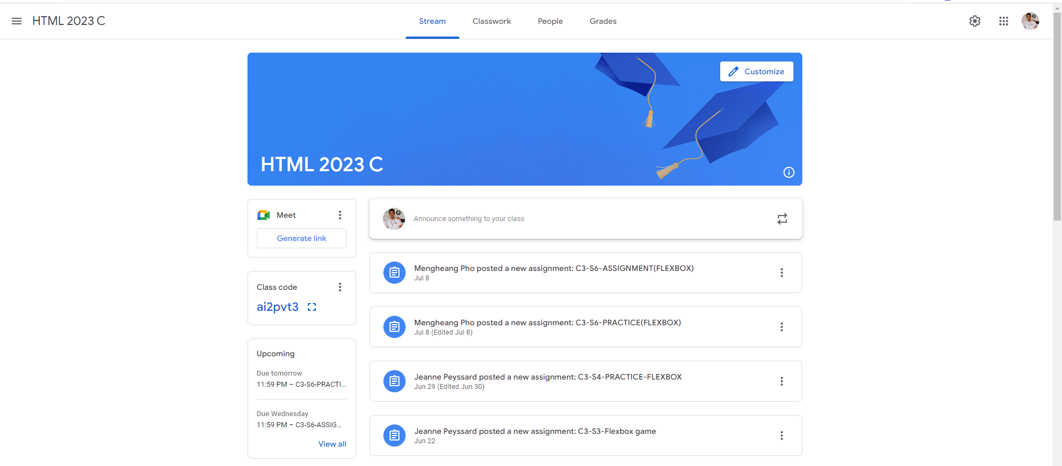
Identify root components of website below

Slide 2
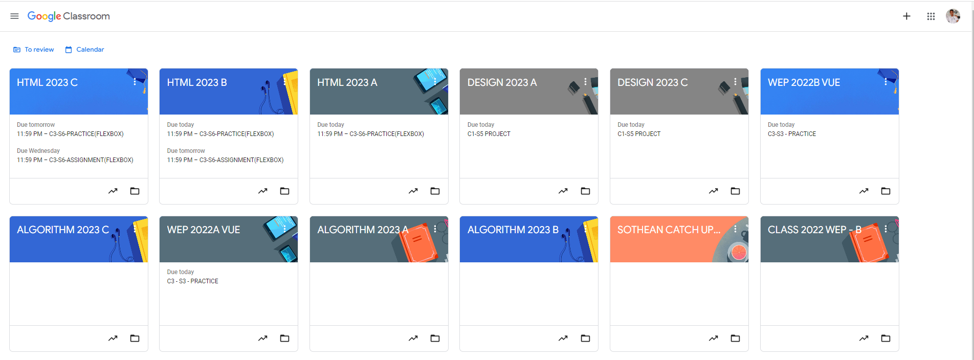
Root div
- Height: 100vh
content
nav
Flex: 0
header
Flex: 0
Flex: 1

Slide 4
header
main

Slide 5
Main-title
Main-content

Slide 6

Header left
Nav-bar
Header right
Main sidebar
Primary content

Slide 7
icon
text
tool

